Slide 1
DIAGEO - KILKENNY
KARL KENT
DOYLE KENT PLANNING PARTNERSHIP

Slide 2
Kilkenny 1780

Slide 3
The Archetypal hiberno-norman town
A walled settlement on a river
Town lies between the the two powers of mediaeval society – church and state
The long main street lined with burgage plots at right angles
Little change in first half millennium

Slide 4
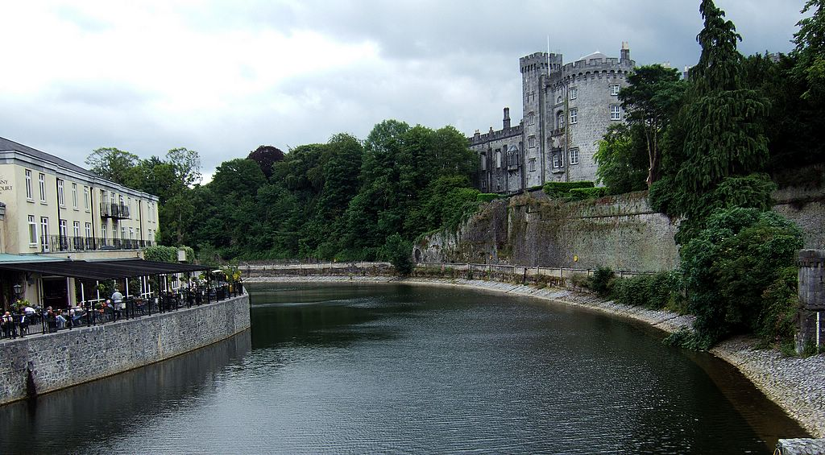

Slide 5
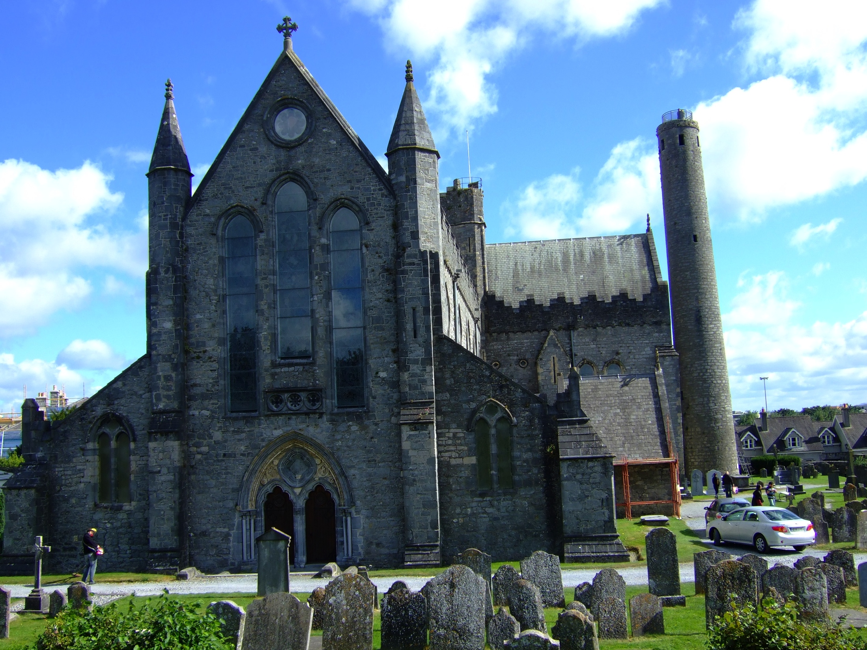

Slide 6
Two poles
The historic city has two poles of attraction – the castle and the cathedral – visual stops to the mediaeval city
How to fill in the gap between them
Must pay deference to these

Slide 7
Kilkenny today
Population 24,423 in 2011
The wall is now succeeded by the ring road
Power structures more complex
Diageo site is strategically located
Diageo site is a small part of the whole

Slide 8
Modern kilkenny
Significant geographical spread
Ring road not complete
Central Access Road underway

Slide 9
Site in planned context

Slide 10
Constraints map
Significant constraints:
Water courses
Roads
St. Francis Abbey
Flood protection
Traffic

Slide 11
Development indicators 1
City centre location – major strength
The Nore – fantastic opportunity – open up to river
Flooding a potential weakness – either barrier (e.g. as on Waterford Quays) or ensure floor levels adequate
Breaga River – opportunity for riverside amenity – line of city wall

Slide 12
Breaga river

Slide 13
Development indicators 2
The proximity of the mediaeval city and location between the castle and cathedral – indicate need for a finer grained approach – notwithstanding scale and texture of existing brewery buildings
St Francis Friary – national significance in terms of architectural/cultural heritage
Friary – of considerable visual significance and could be a centre piece in public realm
Smithwicks brewery visitor centre – an attraction to visitors and of architectural heritage value – should be integrated into development

Slide 14
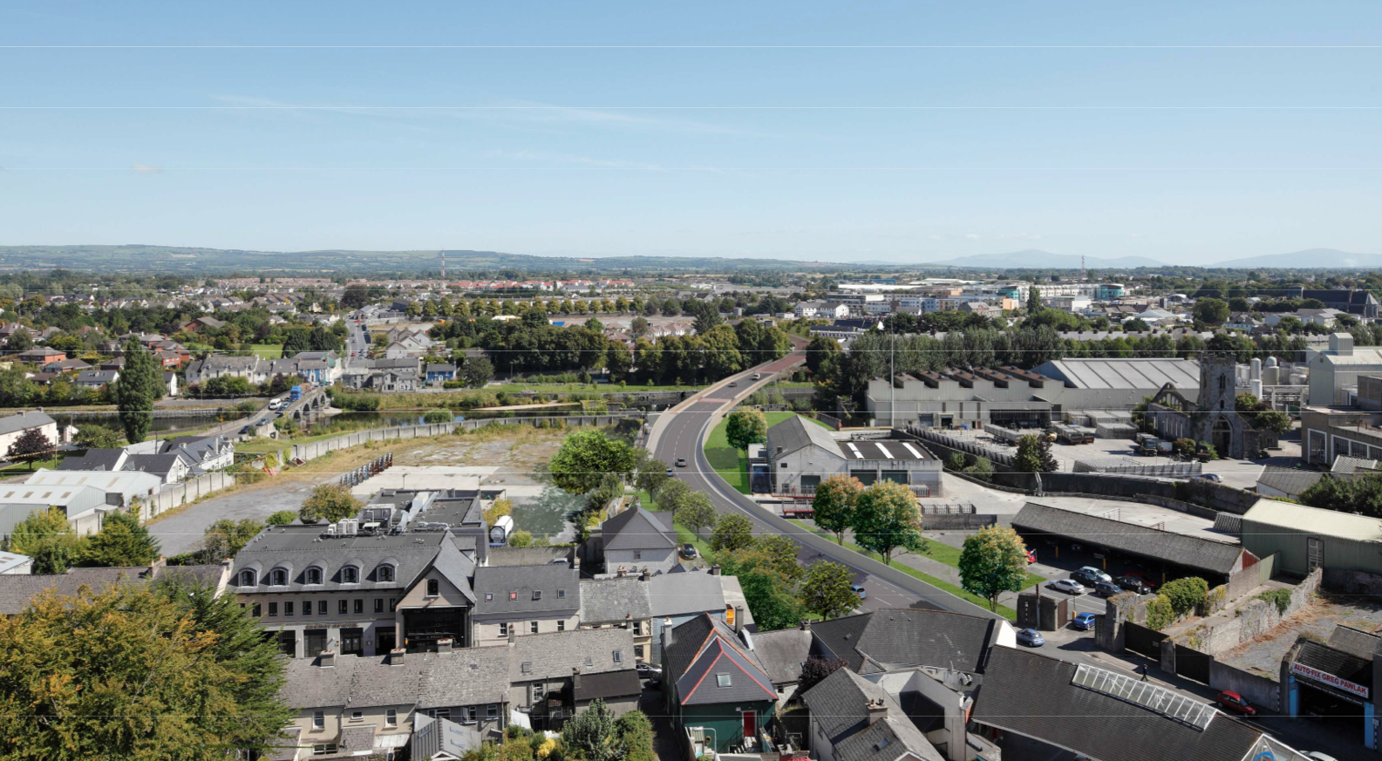
View of central access from cathedral tower

Slide 15
Development indicators 3
Existing traffic situation will improve with Central Access Scheme
Must provide for reasonable level of car access – public transport not an option at present
Keep heavy traffic generators to northern end of site
Strengthen permeability of site by linking to existing and proposed pedestrian/cycle network

Slide 16
LAP TRANSPORT OBJECTIVES

Slide 17
permeability
Northern vehicular access off new Central Access
Secondary access via John’s Bridge
Minimise use of existing vehicular access via Parliament St.
Link to existing pedestrian network including new access to south of theatre
New pedestrian bridge over Nore (or relocate planned bridge from Library )

Slide 18
Development indicators 4
The visual dominance of the cathedral should be protected in views from the site
The scale of new development should generally not exceed four storeys commercial or five storeys residential – plus penthouse level set back

Slide 19
Cathedral seen from site

Slide 20
Possible model - Kassell unterneustadt

Slide 21
Kassel unterneustadt

Slide 22
Kassell unternuestadt

Slide 23
Land uses
Mixed use including limited retail is desirable plus accommodation for elderly
Kilkenny has a large surplus of residentially zoned land on the periphery
Would be suitable for a mix of tourism/culture – St. Francis Abbey and brewery remains as part of cultural trail
Would be suitable for a mix of education and enterprise – design and crafts including food

Slide 24
Suggested site allocation
Southernmost part – education, with a feature building
Central part around Friary – urban square
Between Breaga and Central Access – starter units with limited retail
Northernmost – to north of new Central Access – accommodation for elderly

Slide 25
Possible model - Ryan Academy

Slide 27
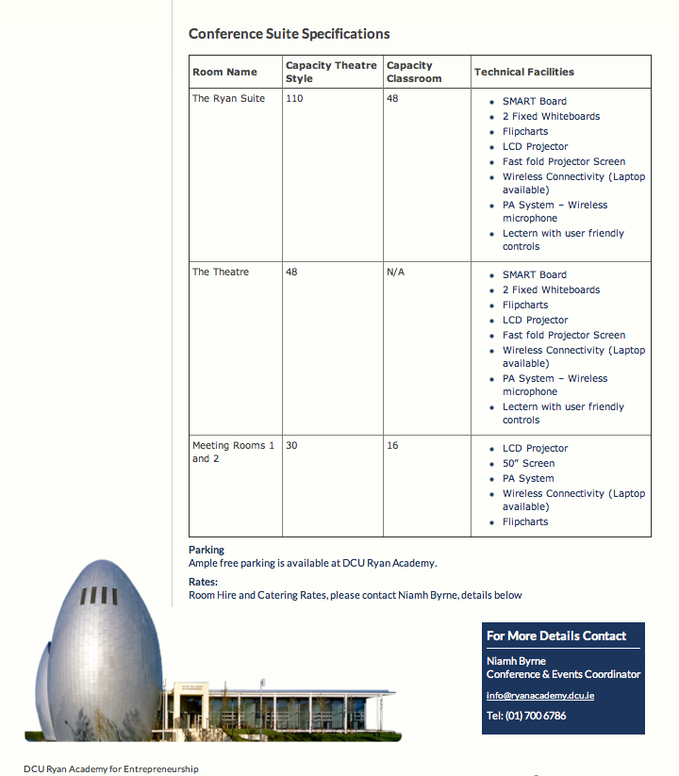

Slide 28
View from castle

Slide 29
Thank you
Karl kent b.arch. Mubc. Friai. mipi
Doyle kent planning partnership

